Slide 1
Object Detection in Ultra-High Resolution Satellite SAR Data via Adaptation of a YOLO Model
Cristian Andreoli
University of Pavia - Department of Electrical, Computer, and Biomedical Engineering
March 18, 2025
Notes:
Good morning, everyone. My name is Cristian Andreoli, and today I’ll be presenting my work on Object Detection in Ultra-High Resolution Satellite SAR Data via Adaptation of a YOLO Model.

Slide 2
Table of contents
01
02
03
04
Introduction and Context
Dataset and Preprocessing
Applications of SAR, Specific Challenges of SAR Images, Objective
ICEYE Satellite Images, Object Annotation and Challenges, Ground Truth Generation
Proposed Models
Conclusion and Future Work
Yolo, Clay for Earth Observation
Summary and Future Developments
Notes:
Here is an overview of the main sections we’ll cover:
I’ll begin with an introduction and context for the research, then discuss the dataset and preprocessing steps. Next, I’ll outline the proposed models and conclude with our key findings and future work.
We’ll explore each section in detail.

Slide 3
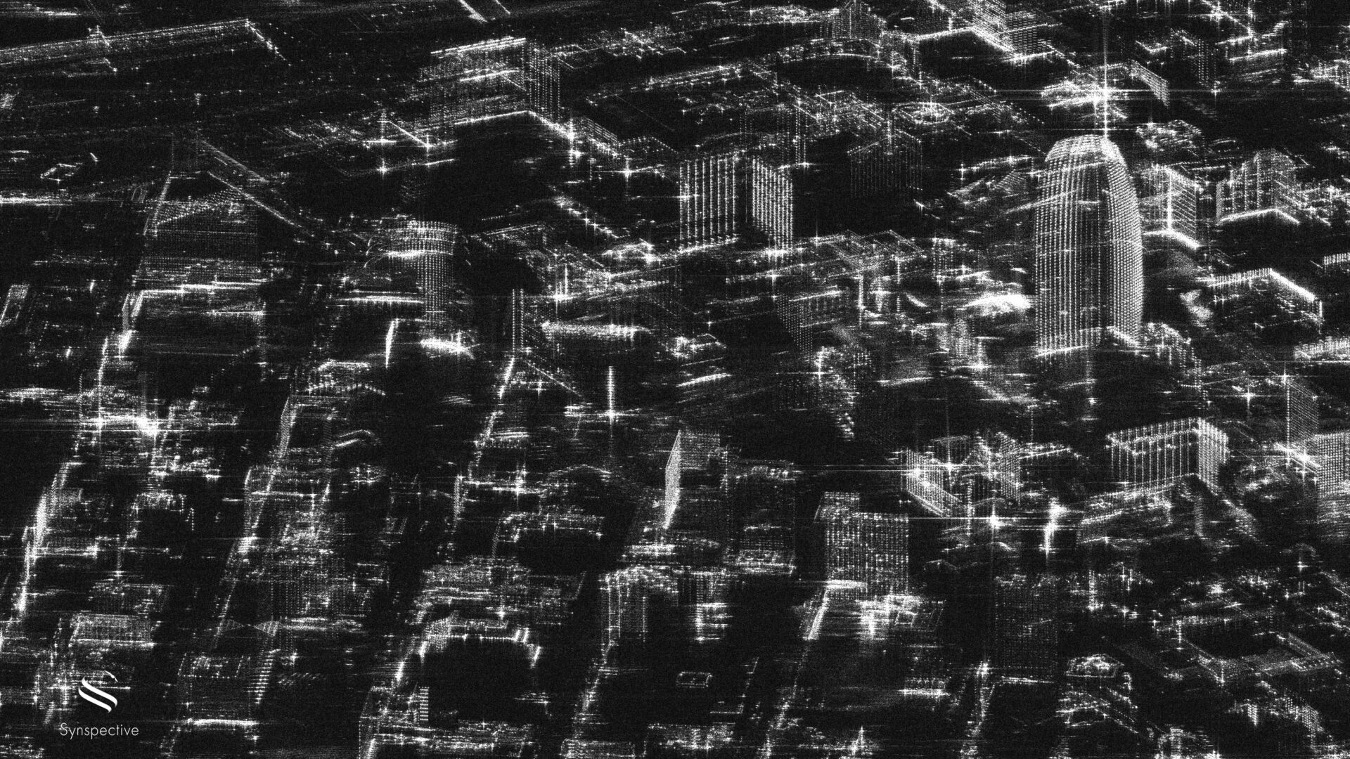
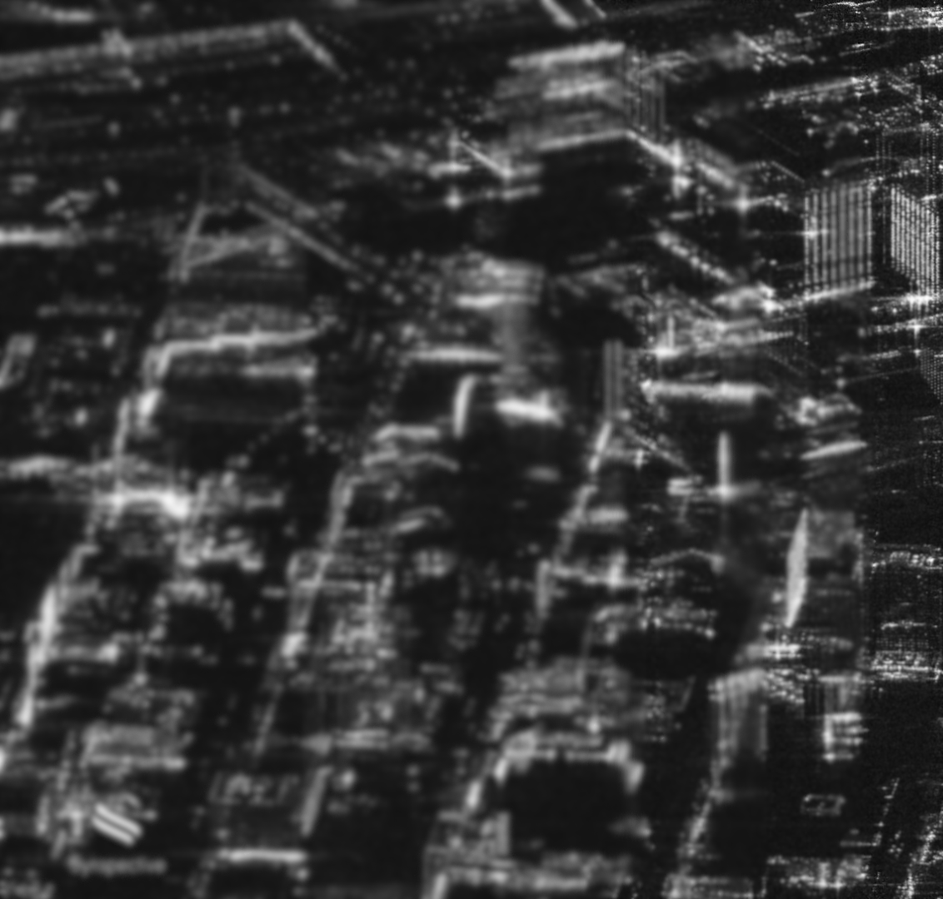
Introduction and Context
Applications of SAR, Specific Challenges of SAR Images, Objective
Notes:
Let’s start with an introducing to ICEYE.

Slide 4
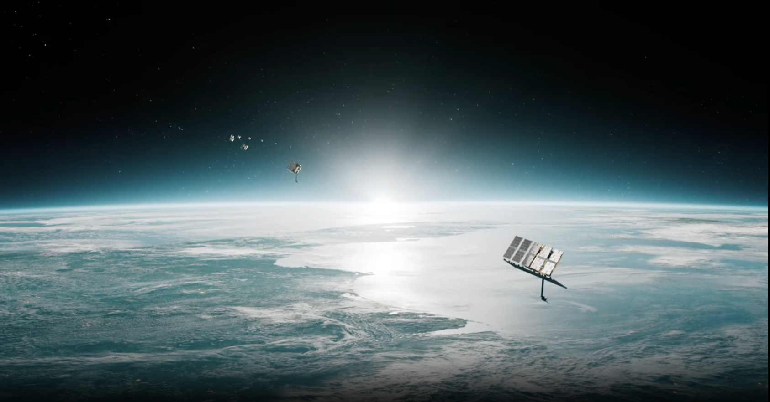
Industrial Internship: ICEYE
Actionable Intelligence through Earth Observation
Notes:
I conducted this research during my internship at ICEYE, a pioneering space technology company that specializes in designing and operating small synthetic-aperture radar (SAR) satellites for Earth observation. ICEYE operates a growing constellation capable of near real-time imaging, which provided the ultra-high-resolution data used in this study.

Slide 5
Applications of SAR (Synthetic Aperture Radar)
SAR uses microwave radar signals to illuminate the Earth’s surface, capturing backscatter regardless of weather or daylight.
By processing signals collected as the sensor moves, it emulates a large antenna and achieves high resolution.
Unlike optical sensors, SAR does not rely on sunlight, making it ideal for continuous Earth observation.
Wide Range of Applications:
Monitoring
Security
Environmental applications
Notes:
Synthetic Aperture Radar, or SAR, uses microwave radar signals to illuminate the Earth’s surface and capture the returning echoes, regardless of weather or daylight. By processing the signals collected as the sensor moves, it effectively simulates a large antenna, providing high-resolution images. Unlike optical sensors, SAR doesn’t rely on sunlight, making it ideal for continuous Earth observation. These capabilities enable a wide range of applications, including monitoring, security, and environmental analysis.

Slide 6
Specific Challenges of SAR Images
Acquisition Geometry:
Side-looking nature causes distortions
Double Bouncing Phenomenon:
Can produce false or duplicated reflections
Speckle Noise:
Granular noise affecting image clarity
Notes:
Despite its advantages, SAR images come with unique challenges. The side-looking geometry can lead to geometric distortions, making accurate interpretation more difficult. The double bouncing phenomenon can result in false or duplicated reflections, while speckle noise creates a grainy appearance that degrades overall image quality. These issues make the task of object detection particularly demanding.

Slide 7
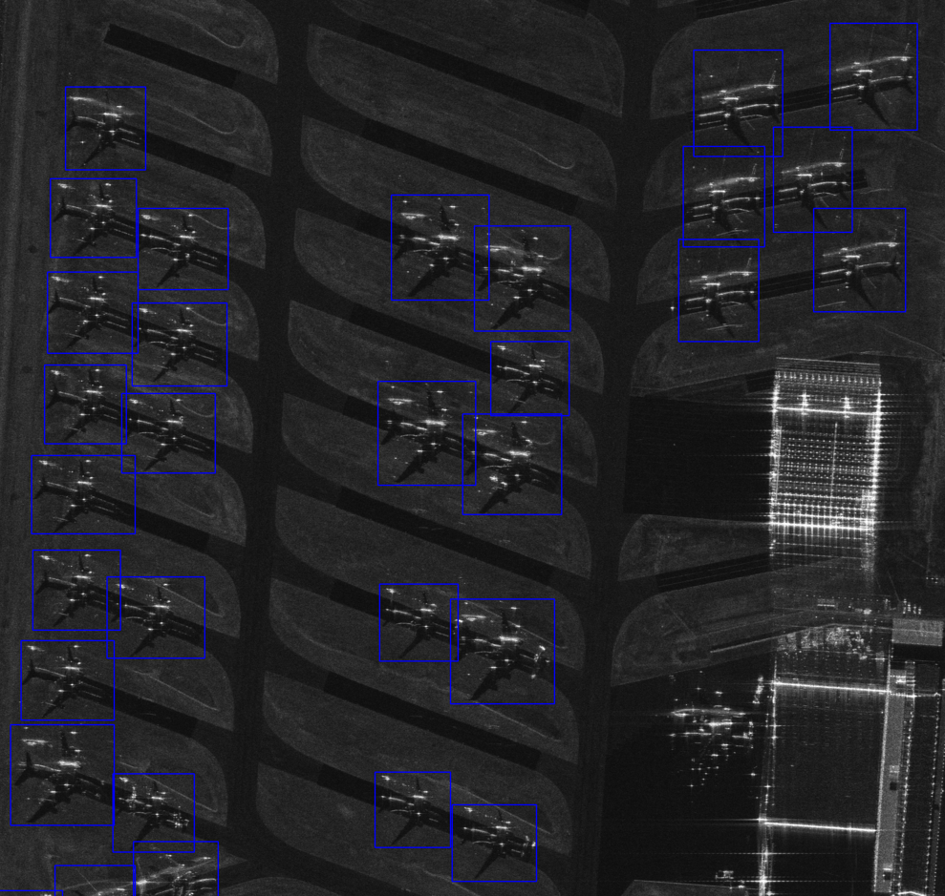
Objective
Primary Objective:
Achieve precise object detection in SAR images
Focus Example:
Detection of airplanes
Notes:
Given these challenges, our primary objective is to develop methods for precise object detection in SAR images. Specifically, we are focusing on detecting airplanes—a task that is critical for applications such as security surveillance. The goal is to overcome the inherent difficulties of SAR data to achieve reliable and accurate detection results.

Slide 8
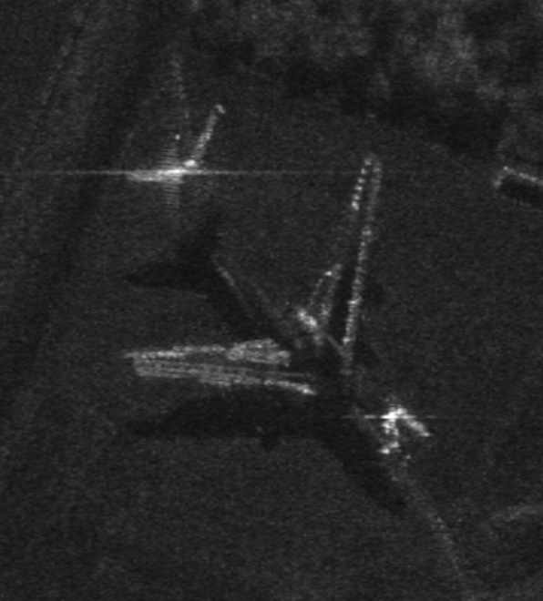
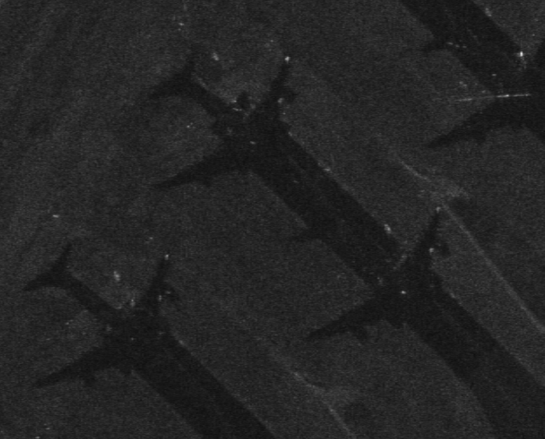
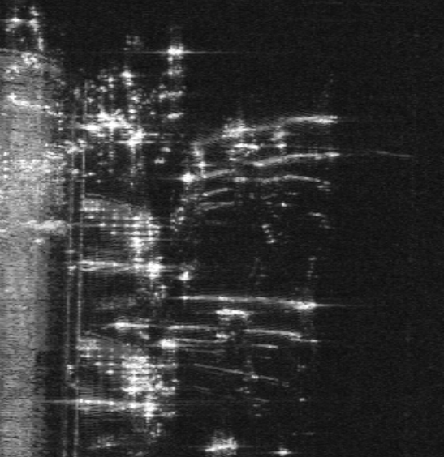
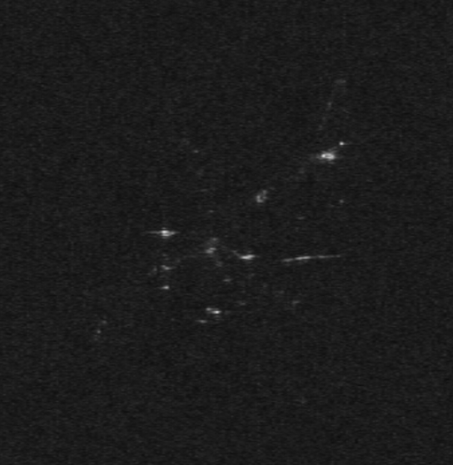
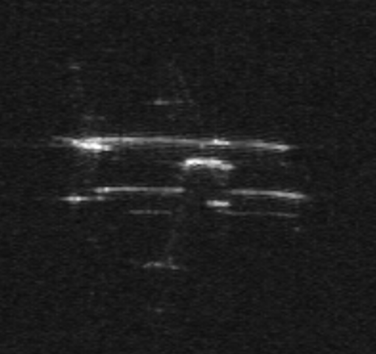
Why this task is difficult
A complex scene where the airplane is close to the Airport’s gate
Clearly visible airplane
Barely visible backscattering
Barely visible backscattering without the shadow
Double bouncing phenomenon
Notes:
To illustrate how challenging this task can be—even for a human observer—these images show airplanes under various conditions. In the first image, both the airplane and its shadow are clearly visible, representing the most favorable scenario. In the second image, some airplanes lack distinct backscattering but remain identifiable thanks to their shadows. In the bottom examples, the shadows are absent, and one airplane is barely visible. Finally, the image on the right depicts a complex scenario where airplanes are surrounded by other structures or objects, making them especially hard to detect.

Slide 9
Research Questions
Effectiveness of standard models (YOLO) on SAR data
Utility of CSI (Colorized Sub-aperture Images)
Trade-off between resolution and computational cost
Hyperparameter optimization
Reducing annotation effort using Foundation Models for Earth Observation (Clay)
Notes:
Five core research questions were formulated:
Can standard object detection models like YOLO be applied effectively to SAR data?
Do colorized CSI images offer detection improvements?
How does ultra-high resolution affect performance and computational cost?
Which hyperparameters (e.g., patch size) are critical?
Can a foundation model such as Clay help reduce annotation effort?
We’ll address these questions throughout the presentation.

Slide 10
Dataset and Preprocessing
ICEYE Satellite Images, Object Annotation and Challenges, Ground Truth Generation
Notes:
Next, let’s look at the dataset and the preprocessing steps we performed. SAR data can be very large, so careful preparation and annotation are essential to ensure accurate detection.

Slide 11
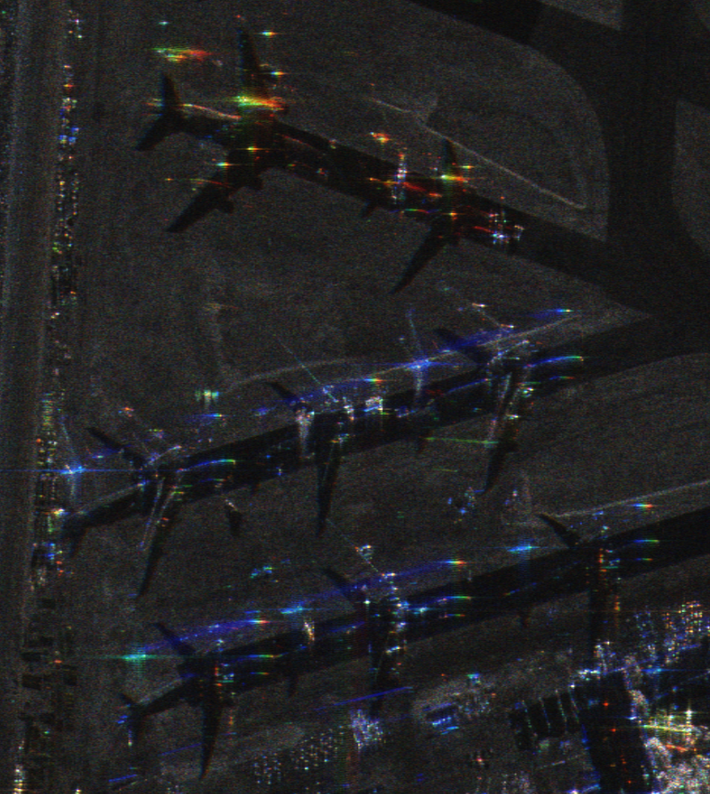
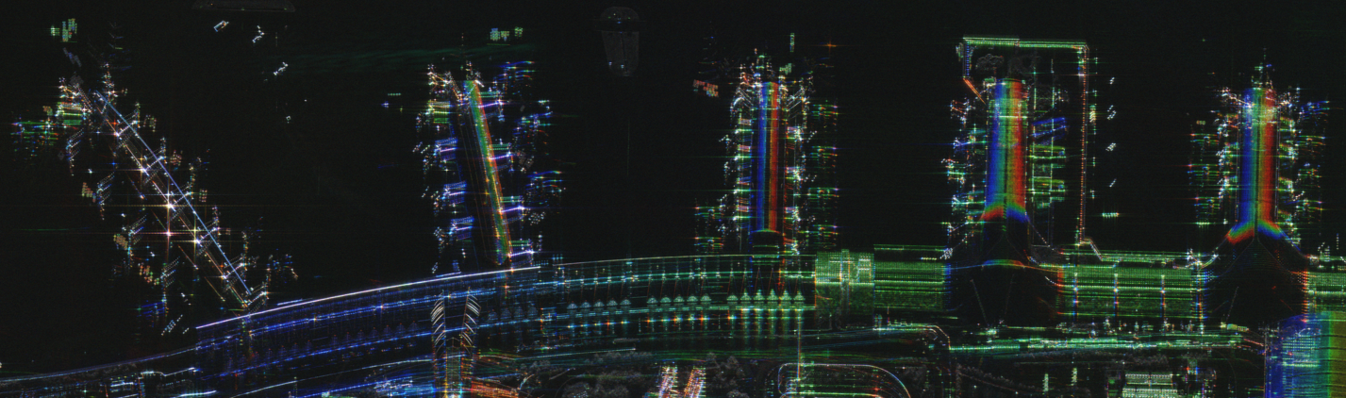
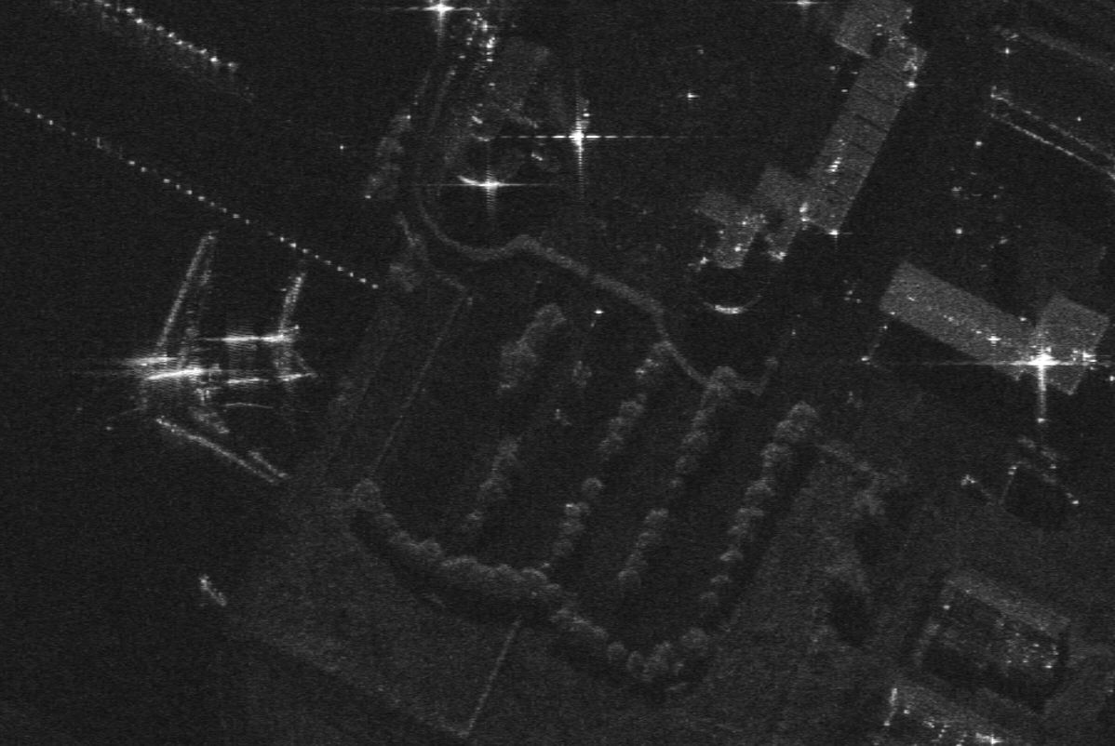
ICEYE Satellite Images
Ultra-high resolution SAR imagery
Acquired from ICEYE satellites
Dataset 2019 Airplanes, 37 acquisitions
Dataset divided in training (80%) and validation (20%)
Notes:
Our dataset is based on ultra-high resolution SAR imagery collected by ICEYE satellites. These images are critical because they offer detailed radar data captured under all weather conditions, which is essential for robust object detection. The high resolution of these images provides rich information, but it also presents unique challenges that we need to address during preprocessing. The Dataset consists of 2019 airplane instances across 37 acquisitions. The dataset was divided in training (80%) and validation (20%).

Slide 12
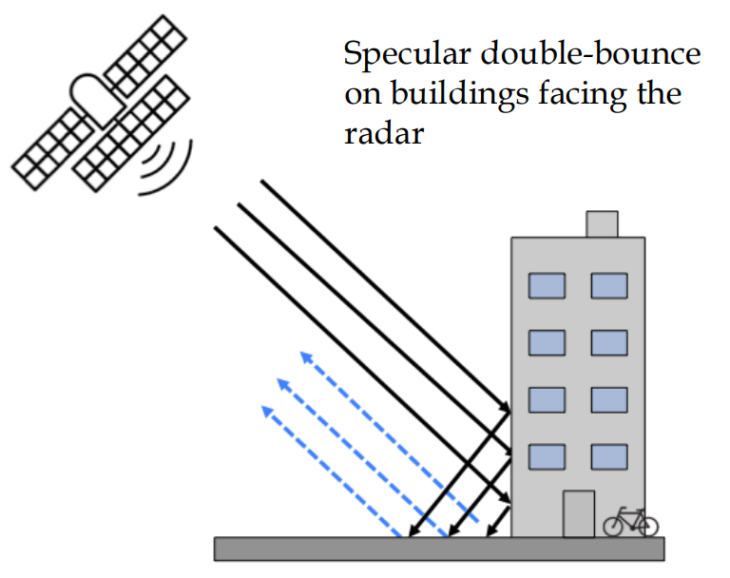
Object Annotation and Challenges
Object Annotation:
Challenges encountered in annotating SAR images
Issues such as speckle noise, geometric distortions, and double bouncing
Notes:
Annotating objects in SAR images is particularly challenging. Due to factors like speckle noise, geometric distortions from the side-looking geometry, and the double bouncing phenomenon, manually labeling these images is not straightforward. These issues can cause ambiguity in object boundaries and sometimes lead to misclassification, making the annotation process a complex but crucial part of the work.

Slide 13
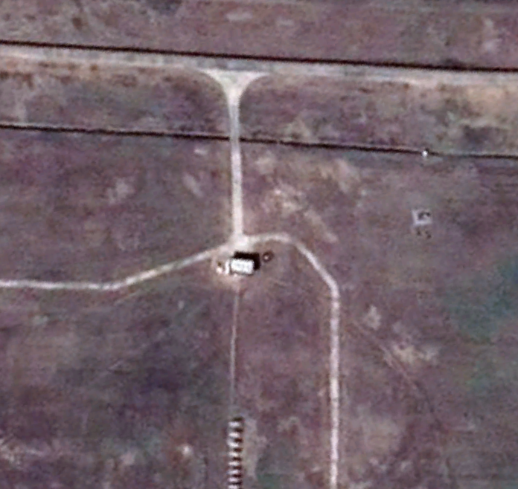
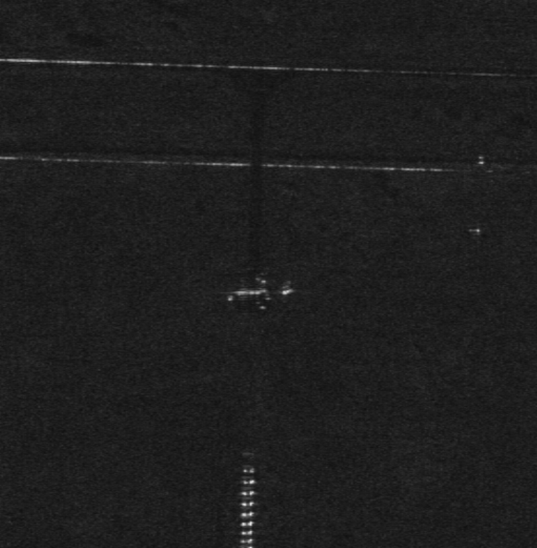
Ground Truth Generation
Accurate Ground Truth in SAR Imagery:
Critical yet challenging for reliable object detection.
Strategies Employed:
Utilizing Shadows for Identification
Multi-Acquisition Cross-Validation
Verification with Ancillary Data (Google Earth Pro)
Notes:
Accurate ground truth in SAR imagery is challenging yet essential. To ensure reliable airplane annotations, I employed three key strategies: first, leveraging airplane shadows to identify aircraft even when backscattering is weak (although shadows can sometimes blend with the terrain); second, using multiple acquisition of the same area from different angles to cross-validate and overcome variability in reflectivity; and third, verifying annotations with Google Earth Pro to avoid mislabeling.

Slide 14



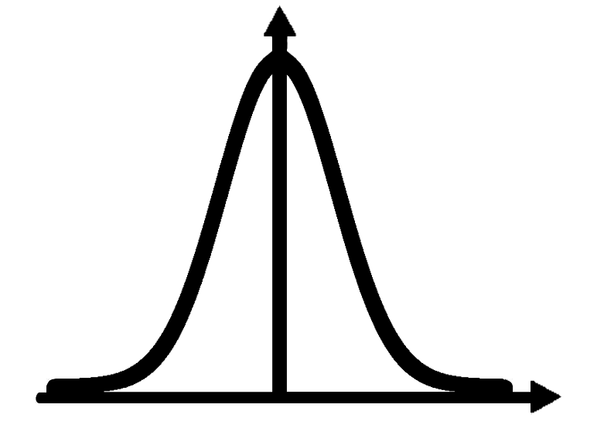


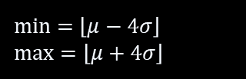
Format Conversion, Calibration, and Image Tiling
GRD Image
Logarithmic Transformation
SAR Data in GeoTiff format
$$10∗\log\left(grd+ε\right)$$
8-bit Scaling
Statistical Clipping
$$(image− min⁡)∗scale$$
min = $\left\lfloor μ−4σ\right\rfloor$
max = $\left\lfloor μ+4σ\right\rfloor$
Notes:
In our preprocessing pipeline, we standardize ICEYE GRD images by converting them into a format suitable for both visualization and deep learning. First, we apply a logarithmic transformation to compress the high dynamic range of the raw data. Next, we perform statistical clipping to mitigate outliers, then convert the images to an 8-bit scale.

Slide 15

Format Conversion, Calibration, and Image Tiling
Image Tiling & Resolution Adjustment:
Resize ultra-high-resolution images to target sizes
Tile images with overlap to capture boundary objects
Exclude tiles without labels
Notes:
Given the extremely high resolution of the images, we resize them to several target resolutions and segment them into overlapping tiles. This overlapping ensures that objects at the boundaries are fully captured, and we discard any tiles that do not contain labels.

Slide 16
Proposed Models
Yolo, Clay for Earth Observation
Notes:
Let’s dive into the models used: yolo and clay.

Slide 17
Yolo Model
YOLOv8 was chosen as the initial model for object detection on SAR imagery primarily due to its ease of use, lightweight nature, and low computational and memory requirements.
With YOLOv8, we could systematically analyze and test key hypotheses regarding:
model complexity
Impact of spatial context and resolution
Comparison of SAR images: GRD vs. CSI
Notes:
YOLOv8 was chosen because it’s easy to use, lightweight, and requires relatively low computational resources. This allowed us to systematically test hypotheses about model complexity, resolution, and whether colorized CSI images provide an advantage over standard GRD.

Slide 18
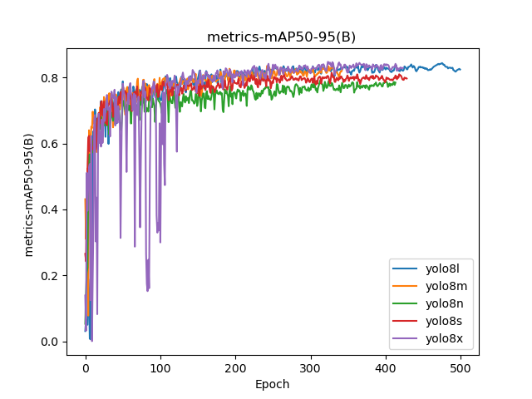
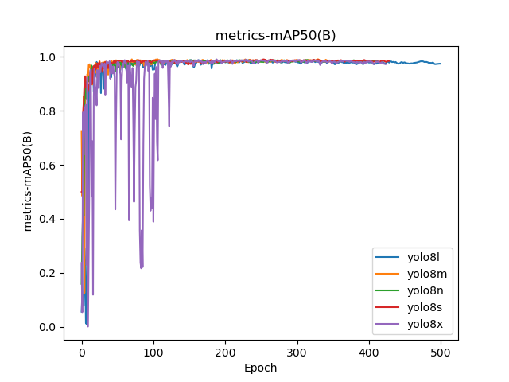
Model complexity
Accuracy
Larger models demonstrated higher accuracy
Instability
Larger models showed signs of early training instability
Notes:
We noticed that larger YOLO models generally yield higher accuracy, but they can show instability during early training.

Slide 19
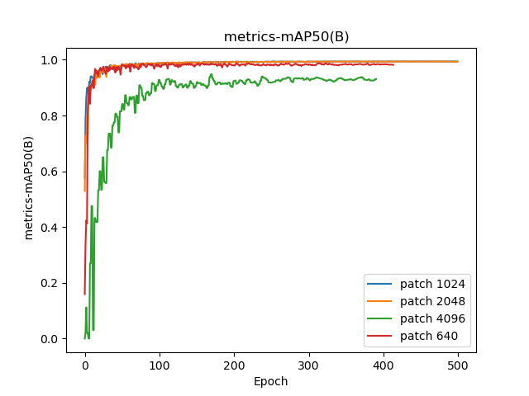
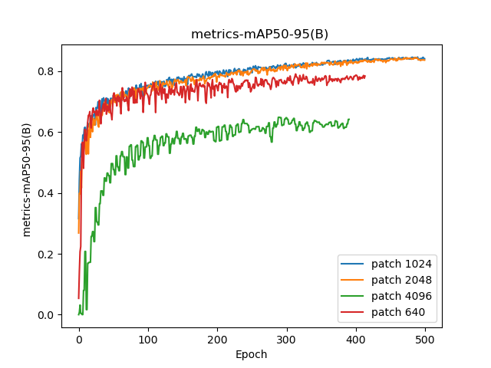
Impact of spatial context
Small objects
Larger patch make the objects relatively, making them harder to detect
Accuracy
Higher spatial context yield a better performance
Notes:
Spatial context matters: using larger patches helps the model understand surrounding areas. However, larger patches also make the airplanes appear smaller, potentially complicating detection. So there’s a balance between context and object scale.

Slide 20
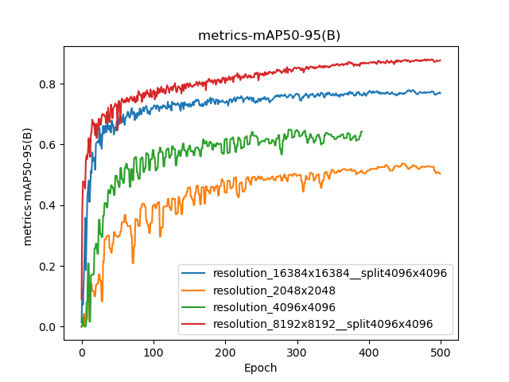
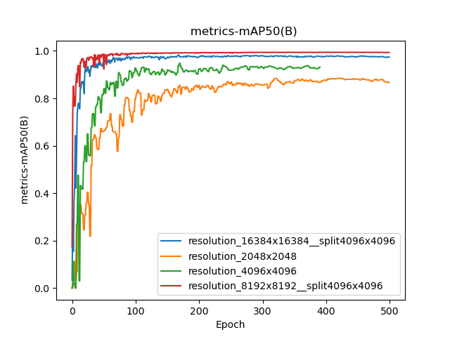
Impact of resolution
Accuracy
High resolution yield a better performance
Computational cost
High resolution causes prohibitive memory costs, requiring the image to be split into patches and reducing context
Notes:
With higher resolution, the model sees more detail, improving detection for small objects like airplanes. But memory usage can become prohibitive, forcing us to tile or scale images. This reduces the global context the model sees, so we must carefully manage the trade-off.

Slide 21
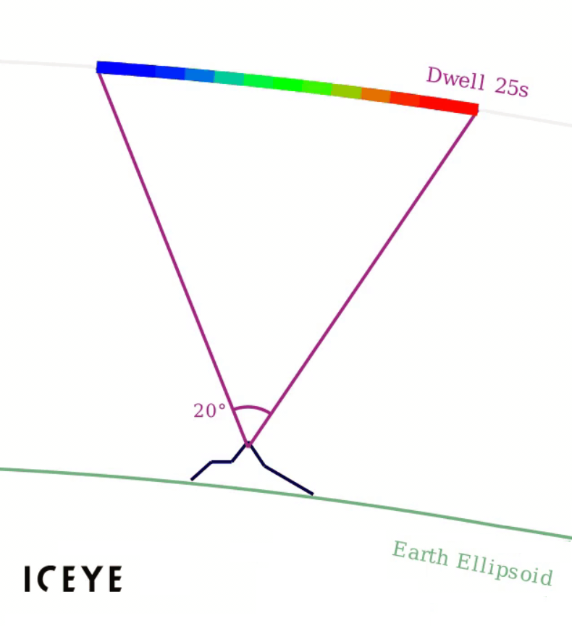
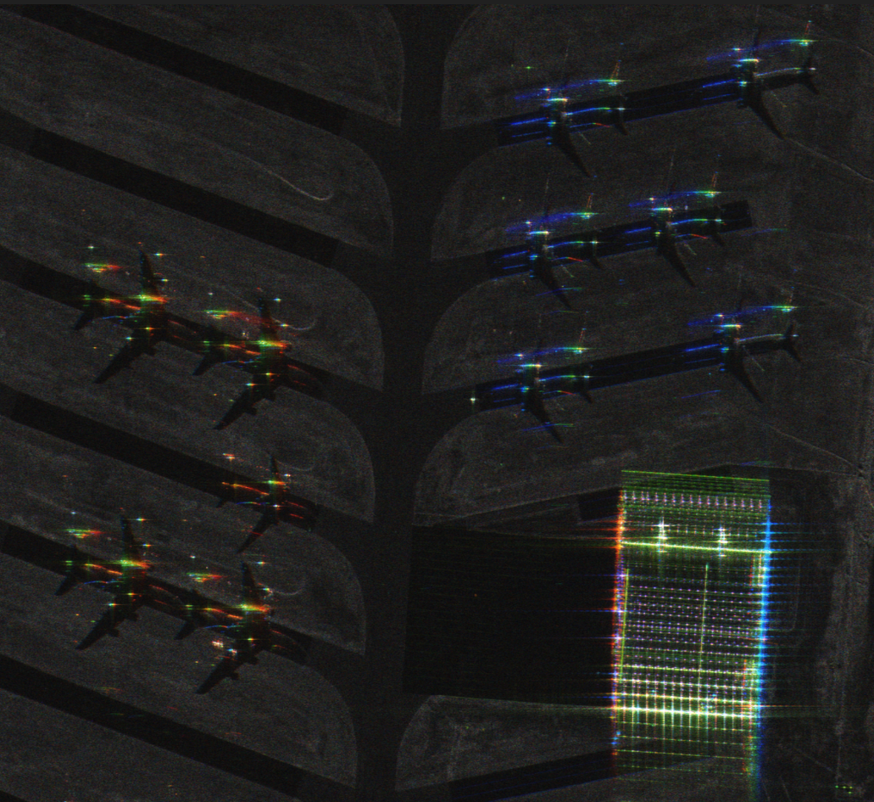
GRD and CSI Comparison
Notes:
Before moving on to the next hypothesis, let’s clarify what makes CSI images different. CSI, or Colorized Sub-aperture Image, encodes multiple viewing angles over a 25-second period into different color channels. Essentially, each color reflects a slightly different backscattering angle.

Slide 22
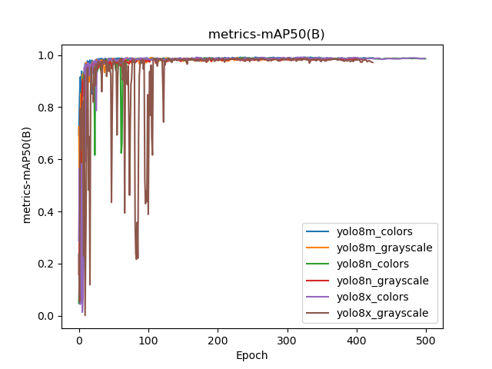
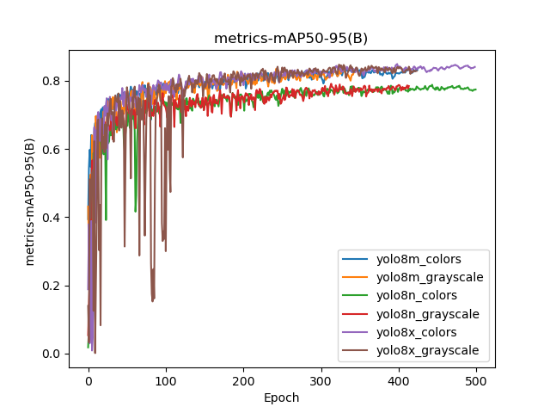
GRD and CSI Comparison
Accuracy
No significant improvement using colors
Notes:
Contrary to our initial expectations, colorized sub-aperture (CSI) images didn’t yield significant improvements over grayscale amplitude-only (GRD). The color information in CSI doesn’t align well with the pretraining on natural images, limiting its benefit.

Slide 23
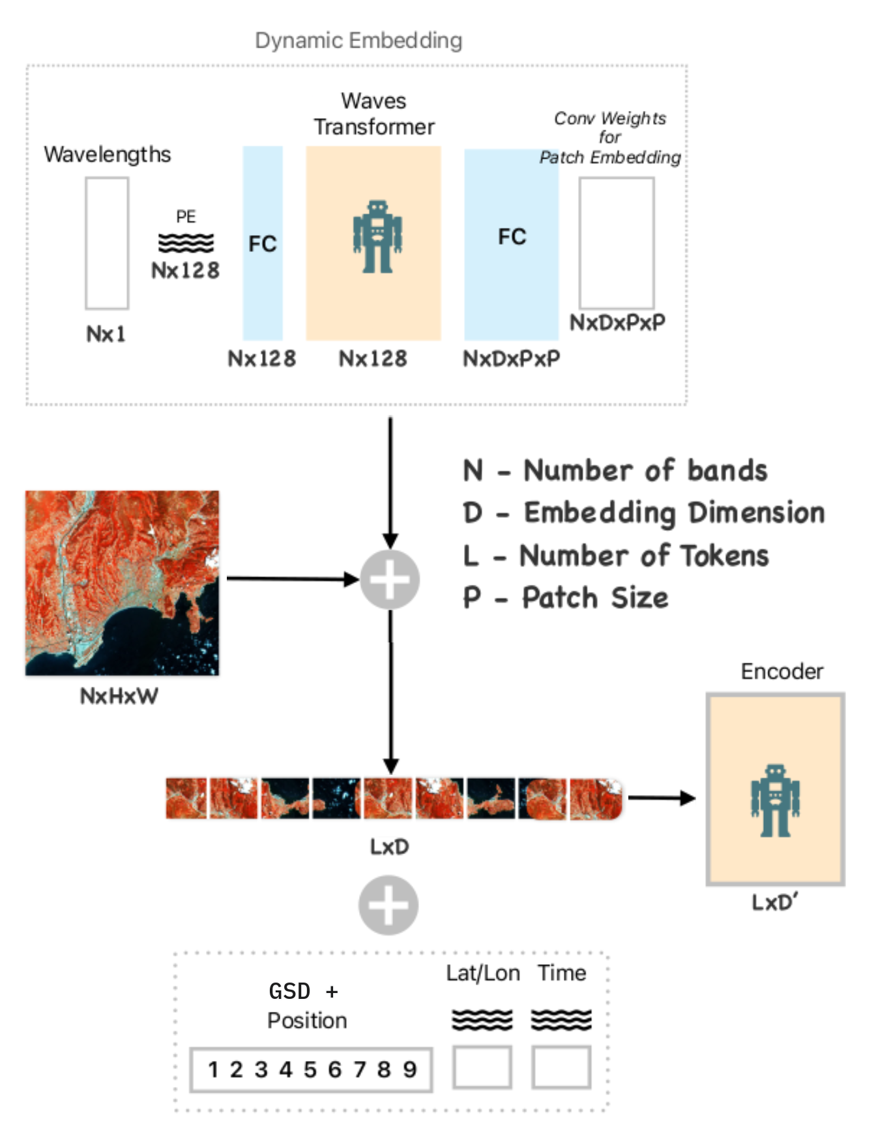
Transformer Model (Clay)
Foundation Model for EO:
Built on a Vision Transformer framework specifically designed for Earth Observation
Backbone for Object Detection:
Replaces conventional CNNs, enabling multi-resolution processing
Unsupervised Training:
Reduces the challenges associated with complex labeling
Notes:
Next, we investigated Clay, a foundation model built on a Vision Transformer. In addition to its self-attention mechanism—which allows it to handle images at varying resolutions—Clay incorporates spatio-temporal embeddings that encode information such as location and time. Moreover, because it’s pretrained in an unsupervised manner, Clay can potentially reduce labeling complexity job. Thanks to these unique characteristics, Clay could also serve as an effective backbone for object detection tasks.

Slide 24
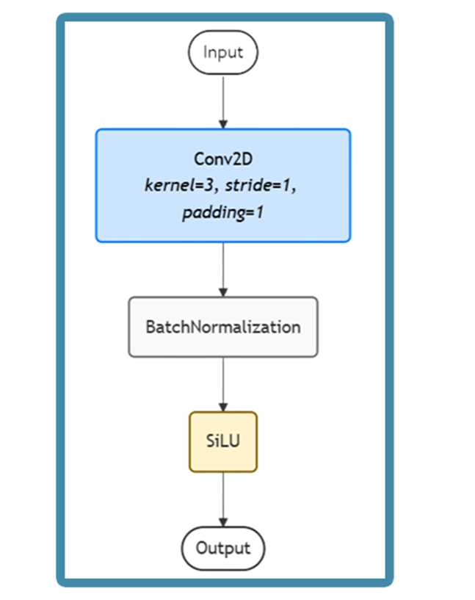
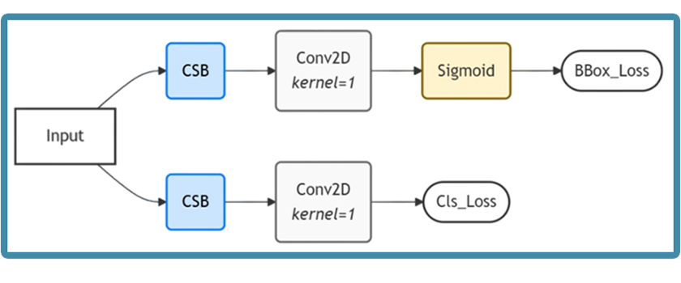
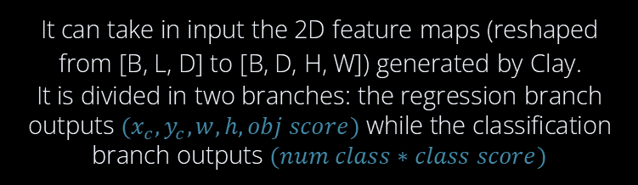
Detection Head
Decouple Detection Head
It can take in input the 2D feature maps (reshaped from [B, L, D] to [B, D, H, W]) generated by Clay.
It is divided in two branches: the regression branch outputs $(x_{c},y_{c},w,h,obj score)$ while the classification branch outputs $(num class∗class score)$
CSB Block
Notes:
To enhance object detection, we designed a dedicated detection head that sits on top of clay backbone. This head decouples the tasks into two branches. The regression branch output five values per bounding box—namely, the center coordinates, width, height, and an objectness score—while the classification branch produces scores for each target class. This separation allows us to optimize localization and classification independently, ultimately boosting detection performance.

Slide 25
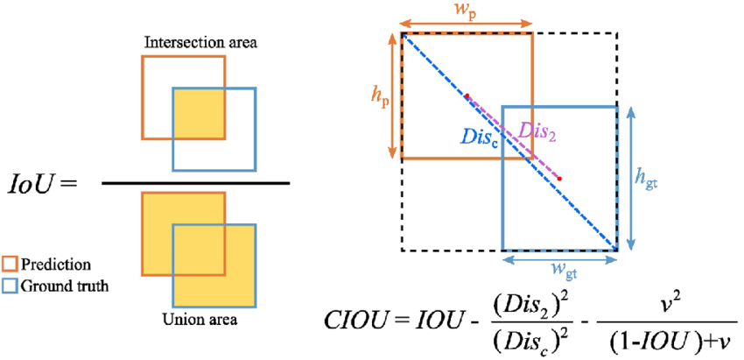



Loss
Objectness Loss
Classification Loss
Coordinate Loss
$$L_{obj}=BCE(\hat{o},o)$$
$$L_{noobj}=λ_{noobj}BCE(\hat{o},o)$$
$$L_{cls}=BCE(\hat{c},c)$$
$$L_{coord}=λ_{coord}[\left(1−CIOU\right)+λ_{w}MSE((\hat{w},\hat{h}),(w,h))]$$
Notes:
Our training is guided by a composite loss function tailored for object detection. The objectness loss, based on BCE, assesses how well the model predicts the presence or absence of objects. The coordinate loss combines CIoU with MSE to ensure accurate bounding box regression, and the classification loss applies BCE for the predicted class scores. Together, these losses form the total loss, averaged over the batch size, which drives the overall detection performance.

Slide 26
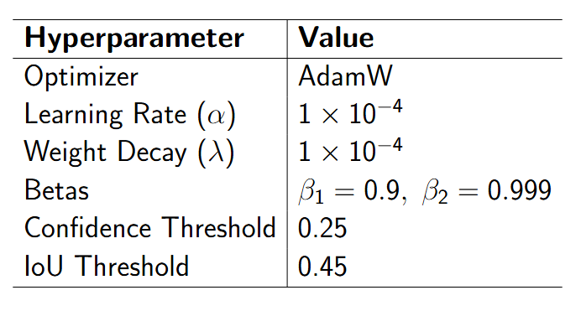
Experiments and Hyperparameters
Two encoder strategies were evaluated:
Trained (Unfrozen): The encoder was updated during training.
Frozen: The encoder parameters remained fixed.
Experiments ran for 500 epochs using the custom total loss and hyperparameters.
Due to the very high cost of the transformer architecture, only low-resolution images with small patch was used for the training.
(4096x4096 resolution, 640 patch)
Notes:
We tested two encoder strategies: one with the Clay encoder trainable (unfrozen) and one frozen. Each experiment ran for 500 epochs using a custom total loss. Due to computational constraints, we limited the resolution and used smaller patches, which might reduce performance.

Slide 27
Results Analysis
Both configurations failed to correctly detect airplanes.
Trained Encoder:
Exhibited clear signs of overfitting, likely due to the limited dataset size and a high number of trainable parameters.
Overfitting compromised generalization capability.
Frozen Encoder:
Reduced trainable parameters mitigated overfitting.
However, airplane detection still did not succeed.
Notes:
Unfortunately, neither configuration succeeded in detecting airplanes. The trainable encoder overfitted—likely due to limited data and high model complexity—while the frozen encoder reduced overfitting but still missed airplanes. These findings highlight the challenges of using Clay in its current form for SAR object detection.

Slide 28
Alternative Backbone Evaluation: ResNet50
Motivation:
Test the performance of the detection head using a conventional backbone
Experimental Configurations:
CIoU + MSE Loss: Coordinate loss include the CIoU and the MSE
CIoU-Only: Coordinate loss include only the CIoU
Notes:
We tested ResNet50 as a more conventional, simpler backbone to evaluate the performance of our detection head. We ran two configurations for the coordinate loss: CIoU plus MSE, and CIoU alone.

Slide 29
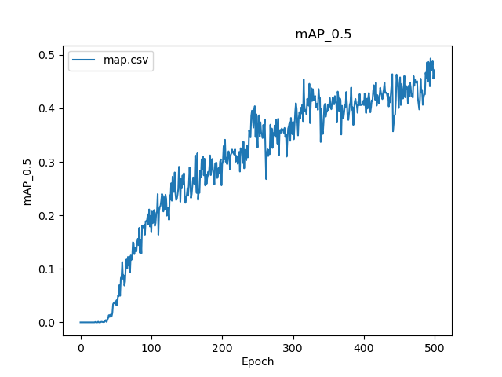
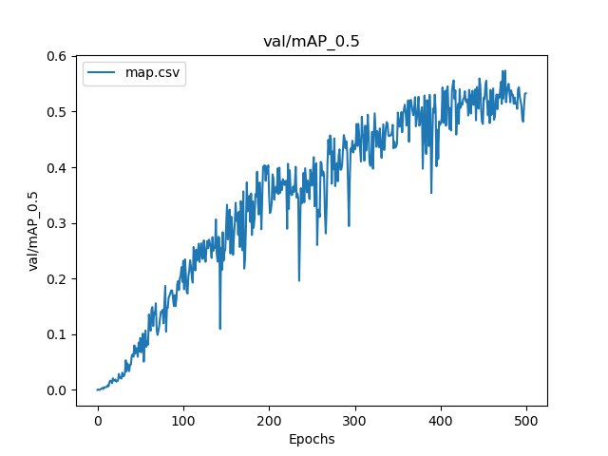
Alternative Backbone Evaluation: ResNet50
Key Finding
Inclusion of MSE loss helped achieve faster convergence and higher mAP
CIoU only initial fails in correctly detect airplanes
CIoU Only
CIoU + MSE
Notes:
We found that including MSE alongside CIoU improved convergence and yielded higher mAP. Moreover, when using only CIoU, the model initially fails to predict correct bounding boxes.

Slide 30
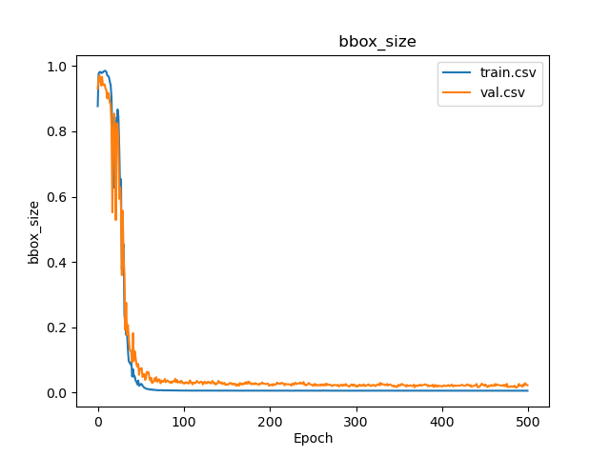
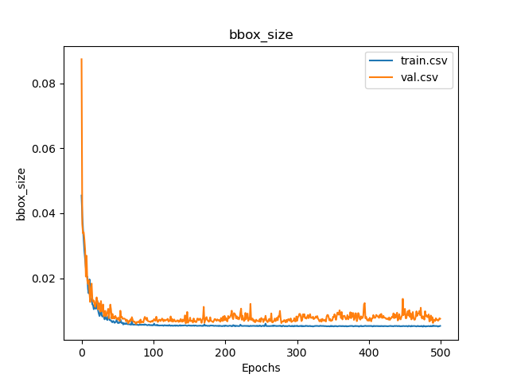
Alternative Backbone Evaluation: ResNet50
Key Finding
The absence of the MSE component resulted in an initial tendency of the network to predict larger bounding boxes
CIoU Only
CIoU + MSE
Notes:
In addition, removing the MSE penalty caused the model to rely on enlarging bounding boxes to maximize IoU. This underscores the importance of a well-chosen loss function that balances box overlap and size penalties.

Slide 31
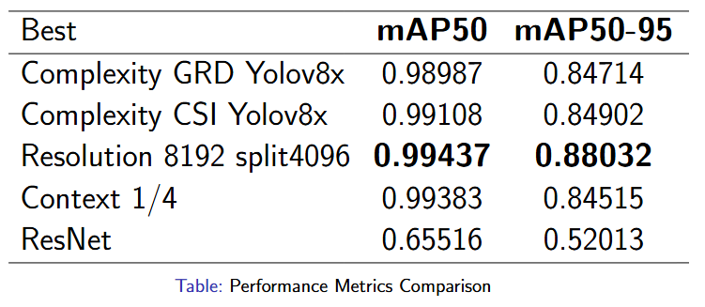
Performance Metrics Comparison
Notes:
Here we see the validation metrics for our object detection model. The table shows that both the mAP at a 0.5 IoU threshold and the mAP computed over a range from 0.5 to 0.95. Best performance are reached with YOLO using a patch of 4096 using a resolution of 8192.

Slide 32

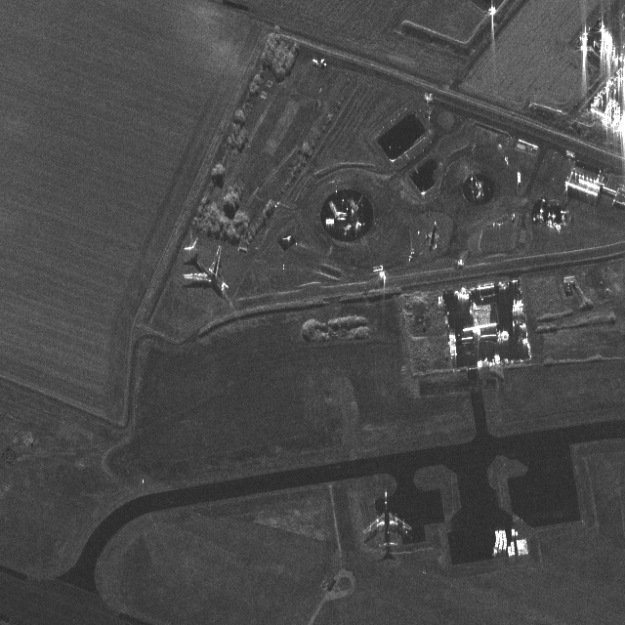
Image Reconstruction Analysis
Key Finding
Global scene is maintained, but small objects tend to vanish
Notes:
To investigate Clay's limitations, the image reconstruction was analyzed. The results show that while the global scene is preserved, small objects such as airplanes tend to vanish, indicating that the encoder favors global features over subtle details. This suggests that retraining or fine-tuning the encoder is essential.

Slide 33
Limitations & Future Improvements
Memory: Large input images or a large batch size can quickly exhaust GPU memory (especially with a ViT).
Compute Requirements: Transformers can be more expensive than CNNs.
Data Augmentation: Additional transformations (domain-specific augmentations for EO).
Dataset Variety: If the dataset is small or lacks diversity, generalization may be limited.
Number of Examples: More labeled data would improve the model, especially if objects are rare.
New Clay Versions: Future releases of Clay or new large foundation models might further improve representation quality (Try v1.5).
Notes:
This slide outlines the limitations we encountered with the current implementation of Clay and suggests directions for future improvements. One challenge is memory consumption—large images or batch sizes can quickly overwhelm the GPU, especially given the demands of a Vision Transformer. Additionally, Transformers typically require more compute power than conventional CNNs. Improving our data augmentation methods could help enhance model performance. The limited variety in our dataset also restricts generalization, so increasing both the volume and diversity of labeled data is crucial. Lastly, newer versions of Clay might offer better representation quality.

Slide 34
Conclusion and Future Work
Summary and Future Developments

Slide 35
Conclusions
Object Detection on SAR Data: YOLOv8, when fine-tuned, is effective for SAR imagery despite pretraining on optical data.
Color Information: Colorized CSI images did not significantly improve detection over grayscale SAR images.
Resolution: Ultra-high resolution improves detection of small objects but increases computational cost.
Patch Size: Optimal hyperparameter selection (e.g., patch size) is crucial.
Foundation Model (Clay): Clay did not yield expected benefits; its pretraining is not well-suited for Object Detection.
Notes:
In conclusion, our research addresses the initial questions as follows. First, YOLOv8—when fine-tuned—is effective for SAR object detection, even though it was pretrained on optical data, demonstrating its transferability. Second, our results show that colorized CSI images do not significantly improve detection compared to grayscale SAR images. Third, while ultra-high resolution improves the detection of small objects, it also increases computational cost, highlighting a necessary trade-off. Fourth, we found that careful hyperparameter selection, particularly regarding patch size, is crucial for achieving optimal performance. Finally, the foundation model Clay did not yield the expected benefits for object detection, indicating that its pretraining is not well-suited to this task. These findings provide clear guidance for future improvements and research directions.

Slide 36
Future Work
Transformer Enhancements: Investigate modifications and domain-specific pretraining for transformer-based models.
Alternative/Hybrid Architectures: Explore other foundation models or hybrid CNN-Transformer approaches.
Dataset Expansion: Increase the volume and diversity of labeled SAR data for more effective fine-tuning.
Deployment Optimization: Research model compression and optimization techniques for cost-effective ultra-high-resolution processing.
Notes:
Possible future directions include exploring enhancements to transformer architectures through modifications and domain-specific pretraining tailored to SAR data. Alternative or hybrid architectures that integrate foundation models with CNNs may also offer improved performance. Additionally, expanding the volume and diversity of labeled SAR datasets could facilitate more effective fine-tuning and better generalization. YOLO can be used as a tool to augment the dataset—by generating initial labels that only require verification and refinement, rather than starting from scratch. Finally, research into model compression and other optimization techniques is crucial for cost-effective processing of ultra-high-resolution imagery.

Slide 37
Thanks for Your Attention

Slide 38
Questions?

